Slide 1

Quiz Generation
Presented By:-
Aniruddha Sawant – 20104011
Pratham Pise - 20104069
Nihaal Varun – 20104040
Yogesh Kumbhar - 20104139
Project Guide
Prof. Neha Deshmukh

Slide 2
Contents
Introduction
Objectives
Scope
Features / Functionality
Project Outcomes
Technology Stack
Block Diagram if applicable

Slide 3
1. Introduction
The “Quiz Generation” project will be developed to overcome the time consuming problem of the manual system.
Problem Identified :
    In current system, checking answer sheets after test wastes the examiners time. Also the examiner have to take efforts for checking the answer sheets. SO this application will do the needful and examination can take place in an effective manner
Solution Proposed :
    To computerize the existing system and help examiners to save their valuable time and important data. This project will help the examiner to manage their job and provide a better service to the candidates.

Slide 4
2. Objectives
To create an appropriate platform for managing MCQ tests.
To overcome the time consuming issues.
To declare the marks of the tests as soon as possible.
To manage information of different tests.

Slide 5
3. Scope
This can be used in educational institutes as well as in corporate world.
No restrictions like the examiner has to be present while the candidate is attempting the test.
We can able to check the correct answers as fast as possible.
Also the candidate can able to see their score after submitting the test.

Slide 6
4. Feature /Functionality
1. Examiners are able to punch the MCQ questions.
2. Users can solve questions for perticular subjects.
3. Examiners can manage the information regarding exam.
4. Correct answers will be evaluated by system.
5. Users can see their score after submitting the test.

Slide 7
5. Outcome of Project
User Can log in
User can able to insert questions and conduct a test.
Users are able to see their scores after attempting the test.
Teacher can able to observe the result of all students who have attempted the test.

Slide 8
6. Technology Stack
Hardware Requirements: -
• Hard Drive: 20 Gb or more
• RAM: 200 Mb and above
• Processor: Intel i3 and above, M1 and above.

Slide 9
Software Requirements: -
• Operating System: Windows 7 and above , MacOS X and above
• Language: Java (17.0.1) LTS
• Knowledge of Java Swings and Object Oriented Programming.
• Development Tools: Eclipse IDE

Slide 10
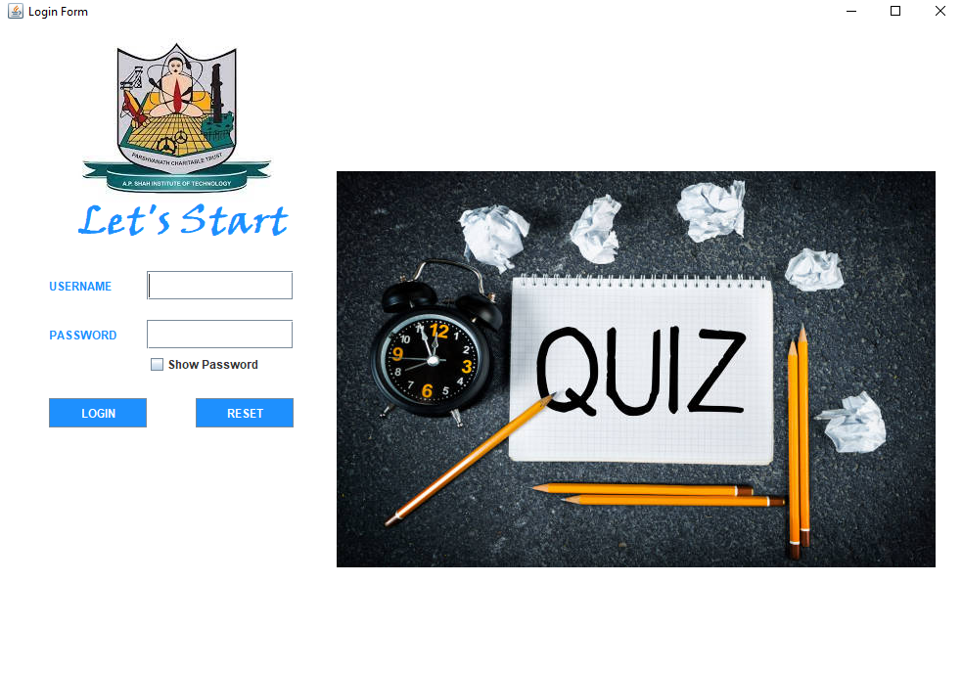
IMPLEMENTATION
LOGIN
PAGE

Slide 11
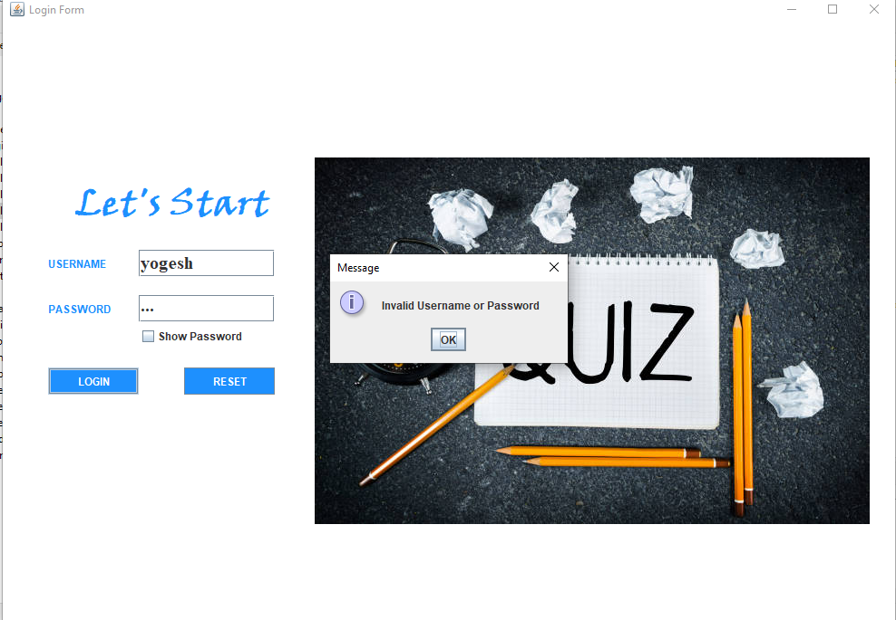

Slide 12


Slide 13
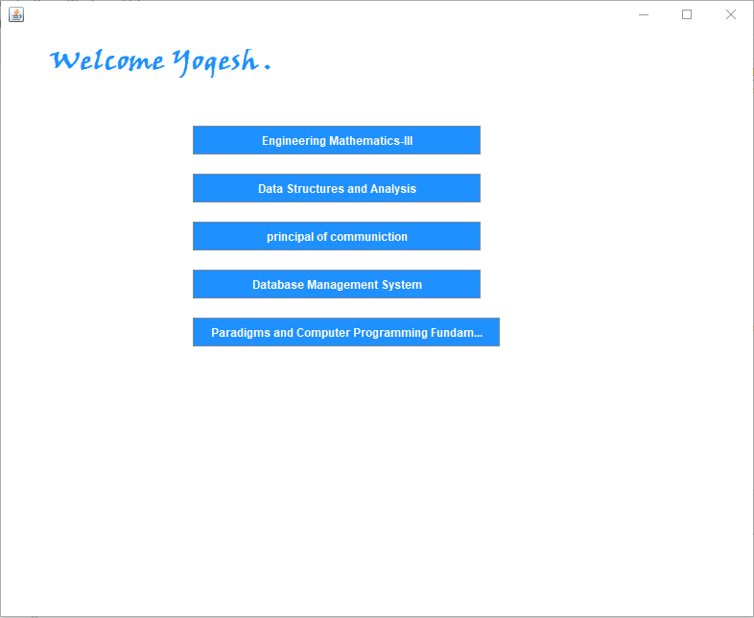
SELECT
SUBJECT

Slide 14
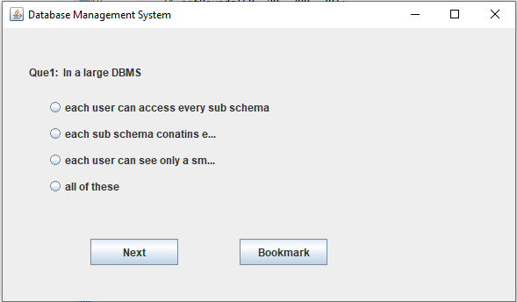
Attempt Quiz Questions

Slide 15
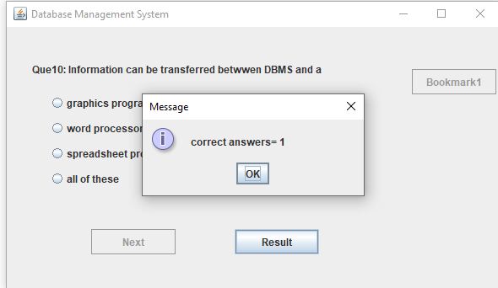
Check Your
Result

Slide 16
7. Block Diagram
User
Login ID
Invalid ID
Valid ID
Select Subject
Score/End
Attempt Quiz Questions
Result

Slide 17
Thank You...!!

